Slide 1
Dual-Bootstrapping Curve Building
Joseph Ye & Nicholas Burgess
March 2018

Slide 2
A Normal 3M Swap Curve
Take the EUR 3M curve for example. Let’s see what makes up this curve.
Typically we need these instruments to build this curve:
    3M Libor fixing rate
    8 IMM Futures
    16 Interest Rate Swaps (3Y, 4Y, 5Y, 6Y, 7Y, 8Y, 9Y, 10Y, 11Y, 12Y, 15Y, 20Y, 25Y, 30Y, 40Y, 50Y)

Slide 3
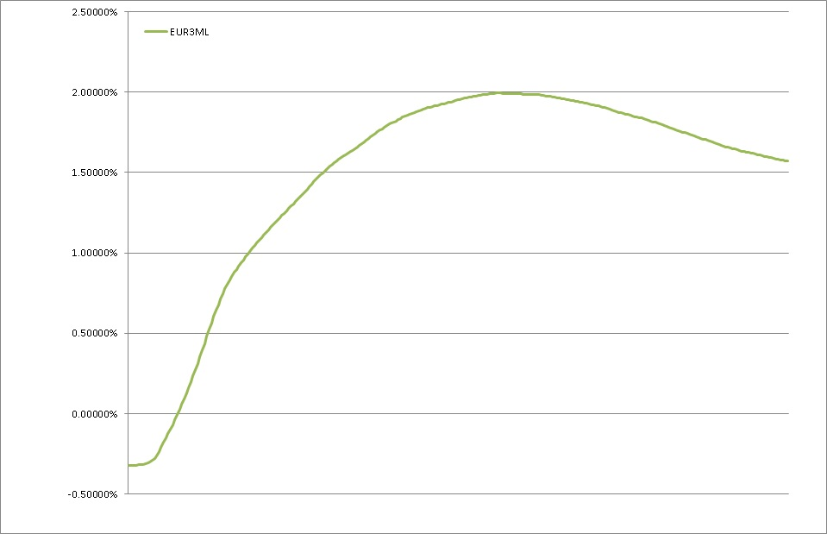
What Makes Up a 3M Swap Curve
The rest of the points are interpolated by the complex Linear Spline Interpolation method

Slide 4
What is in a 3M Swap Curve?
Then, we go ahead and calibrate a 3M curve.
After that, you can use this curve to price a 3M swap.
Simple Right?
But …
What exactly have we calibrated in this 3M curve?
or
What have we created as the 3M curve?

Slide 5

What is in a 3M Swap Curve?
Answer:
We have produced a series of discount factors representing the 3M forward rates.
Why discount factors?
    From input’s point of view:
      There is always a way to deduce a discount factor on the target curve from a calibration instrument’s market price, i.e. the input price.
    From output’s point of view:
    Discount factors can be directly used to deduce forward rates
    What do we need to price a 3M interest rate swap?
    3M forward rates!

Slide 6




3M Swap Curve - From Inputs to Outputs
PV formula for a Eurodollar futures contract:
PV formulas for a vanilla interest rate swap:
Unknown discount factors
All Known!

Slide 7

3M Swap Curve - From Inputs to Outputs
Pricing formulae of the calibration instruments are used to collectively produce the discount factors of the target curve on all the tenor nodes through a mixture of
Regular bootstrapping
and
Mathematical Optimization (Solving)

Slide 8

3M Swap Curve - From Inputs to Outputs
In the pricing formulae, one of the known parameters is
This is the discount factor from the OIS discounting curve.
It’s known because the OIS curve has already been created.
This is the old way of building curves:
– sequentially, one curve is built after another
– at any one point, there is ALWAYS only one unknown: the discount factor of the current curve
But what if ..
The OIS curve has not yet been built and its discount factor is also an unknown??

Slide 9
Global Yield Curve Engine
So now we don’t know the discount factors of the 3M swap curve,
And neither do we know the discount factors of the OIS curve.
Two sets of unknowns … So how do we do calibrate the 3M swap curve?
Thought Process -
If we are able to calibrate one yield curve when there is only one unknown then …
Does that mean we can calibrate two yield curves when there are two unknowns?
The answer is YES!
How?
We will have to solve for both curves, simultaneously!
We use a Yield Curve Engine

Slide 10
Global Yield Curve Engine
Introducing the concept of Yield Curve Engine
What is a Yield Curve Engine?
    The core of the engine is a giant, cross-curve solver – it solves for discount factors of two or more unknown curves, simultaneously. But, there’s a lot more;
    It’s global – it sees all the calibration instruments on all the curves
    It’s smart – it knows how to inter-link all the instruments together from all the curves since most of these instruments have inter-dependency with each other
    It’s arbitrage free – because it builds its curves simultaneously, no curves in the same engine can be used to create arbitrage opportunities against other curves.
    It’s very accurate – powerful solver insures all calibrated curves can re-price all the input calibration instruments with high accuracy.
    It’s new and advanced – a complete re-design and re-write of how yield curves are built in MHI

Slide 11
Global Yield Curve Engine
How does this Curve Engine work?

Slide 12
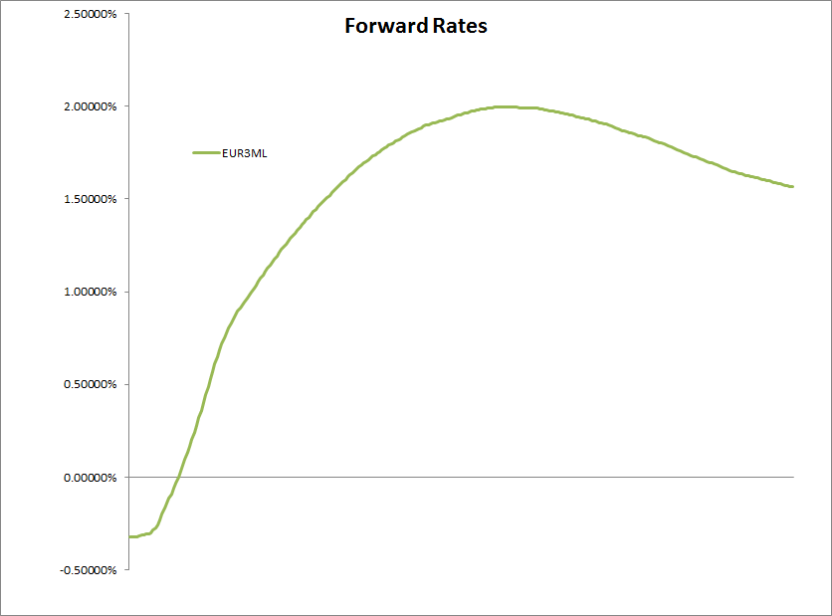
Global Yield Curve Engine
Quickly flip back to single yield curve building (the old way). Let’s take a look at how discount factors are solved.
Image there’s only one input calibration instrument, a 5Y 3M interest rate swap
5Y

Slide 13
Global Yield Curve Engine
Quickly flip back to single yield curve building (the old way). Let’s take a look at how discount factors are solved.
Q: What are we trying to generate from this calibration Instrument?
A: The discount factor at the 5Y point.
5Y

Slide 14
Global Yield Curve Engine
Quickly flip back to single yield curve building (the old way). Let’s take a look at how discount factors are solved.
How?
Solver:
Change the value of the unknown – discount factor at the 5Y point, so that PV of a 5Y swap is 0
5Y

Slide 15
Global Yield Curve Engine
Quickly flip back to single yield curve building (the old way). Let’s take a look at how discount factors are solved.
In reality, we have a lot more calibration instruments.
5Y
6Y 7Y 8Y 9Y 10Y

Slide 16
Global Yield Curve Engine
Now you know how a bunch of calibration instruments are used to build a single curve.
Curve engine works in the same way, conceptually, except that it works with instruments across all the curves at the same time.
And it’s a LOT more complex…

Slide 17
What is dual-bootstrapping?
Dual-bootstrapping means building an OIS curve and a swap curve simultaneously.
So dual-bootstrapping is really just a special case of using the Global Curve Engine, in which case only two curves are simultaneously built in the engine.

Slide 18
Why do we need dual-bootstrapping?
There are inherent problems with the old way of building yield curves.
Old method in MHI:
Yield curves are all built individually and sequentially, one curve after another.
What the real market is like:
Many yield curves are linked and cross-dependent with each other.
How does that affect MHI:
1. Mispricing!
Old yield curves are not self-consistent and not arbitrage free. I could price a 3M swap using the 3M curve to get to one PV, and price the same swap using 6M curve + 3M/6M basis to get to another PV.
2. Incomplete profile of delta risks
Because we are not capturing the synchronous nature of how yield curves move, we are not capturing the cross curve risks when computing delta risks.

Slide 19
Why do we need dual-bootstrapping?
Yield curves built by the Global Yield Curve Engine are free from all of these problems!
Other potential benefits:
Naturally fits in with high-speed large-scale yield curve publishing for a global etrading business;
Naturally fits in with multi currency collateralisation of swap trading;
Naturally fits in with analytical risk calculation;

Slide 20
Thank you

